Slide 1
WIHV DAISEY Basic Navigation Training

Slide 2
Install a DAISEY supported web browser!
Mozilla Firefox is supported!
Google Chrome is supported!
Internet Explorer is NOT supported!
Safari is NOT supported!

Slide 3
DAISEY Data Entry Workflow
Caregiver
Profile
Child
Profile
Link family members
Assessments

Slide 4
What is a caregiver?
In DAISEY, “caregiver” is the label used for any adult receiving services from an organization.

Slide 5
What are profiles?
Profiles are demographic records created for each caregiver and child.
Each caregiver profile is designated as a primary or not primary (secondary) caregiver for the purposes of linking families in DAISEY.
A caregiver or child profile may exist in DAISEY without being linked to any other profiles.

Slide 6
Creating families in DAISEY
Families are created when child or secondary caregiver profiles are linked to a primary caregiver.
primary
caregiver
profile
secondary
caregiver
profile
child #1
profile
child #2
profile
child #3
profile

Slide 7
DAISEY Data Entry Workflow
Caregiver
Profile
Child
Profile
Link family members
Assessments

Slide 8
DAISEY Data Entry Workflow
Caregiver
Profile
Child
Profile
Link family members
Assessments

Slide 9
DAISEY Data Entry Workflow
Caregiver
Profile
Child
Profile
Link family members
Assessments

Slide 10
DAISEY Data Entry Workflow
Caregiver
Profile
Child
Profile
Link family members
Assessments

Slide 11
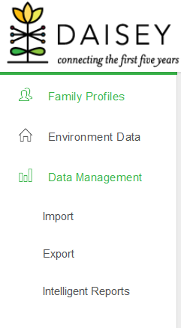
Data Management Tab
The data management tab in the navigation menu contains tools such as import and export.
We will quickly demonstrate how to pull an export

Slide 12
Conclusion
Thank you for attending! Please email us with any
questions at: daisey.wihv@ku.edu

